Slide 1
Crop Prediction Model using Random Forest Classifier
Submitted by:
Name: Aditya Rawat
Roll No.: 8
Section: D
Submitted to:
Dr. Vandana Rawat
Associate Professor
At GEU

Slide 2
Index
Introduction
Project Vision
Technologies Used
Correlation of Dataset
Accuracy of Models
Process Workflow
Process Workflow – flowchart
Conclusion

Slide 3
Introduction
This research presentation introduces you to a Data Science System which is designed to assist farmers in selecting the most suitable crop for cultivating based on the details of the soil. Example – ph level, Nitrogen level, Phosphorus level, and other important metrics. I used Random Forest Classifier Algorithm to provide tailored crop recommendation based on soil analysis.
Sno. | N | P | K | temperature | humidity | ph | rainfall | label
1 | 90 | 42 | 43 | 20.87974371 | 82.00274423 | 6.502985292 | 202.9355362 | rice
2 | 71 | 54 | 16 | 22.61359953 | 63.69070564 | 5.749914421 | 87.75953857 | maize
3 | 40 | 72 | 77 | 17.02498456 | 16.98861173 | 7.485996067 | 88.55123143 | chickpea
4 | 23 | 72 | 84 | 19.02061277 | 17.13159126 | 6.920251378 | 79.92698081 | chickpea
5 | 13 | 60 | 25 | 17.13692774 | 20.59541693 | 5.68597166 | 128.256862 | kidneybeans
6 | 9 | 66 | 21 | 30.11812084 | 34.13307843 | 5.719889876 | 157.0858232 | pigeonpeas

Slide 4

Project Vision
The vision of the project was to revolutionize crop selection process in agriculture by making them more precise, efficient and sustainable. By using the power of artificial intelligence and data science, we aim to empower farmers with a tool, which will help them by providing accurate and personalize crop recommendation based on the soil analysis.

Slide 5



Technologies used
Technologies Used:
Python: we used python as the major programing language. It is used to train the Machine Learning Algorithm i.e. Random Forest Classifier and other pre-processing methods.
Scikit-learn: It is used to access the pre-processing features such as MinMaxScaler (for normalizing the data) and StandardScaler (for standardization the data). It was also used to train the Random Forest Classifier Model using train_test_split.
Flask: we used Flask web frame work to connect the Crop Prediction Model with the HTML website

Slide 6
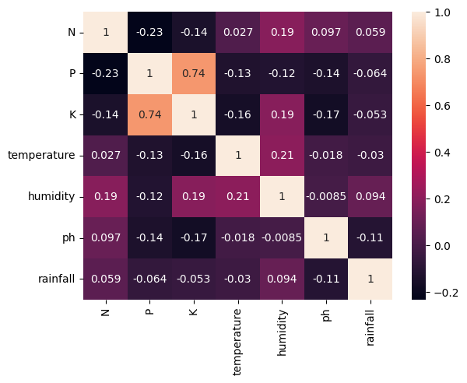
Correlation of Dataset

Slide 7
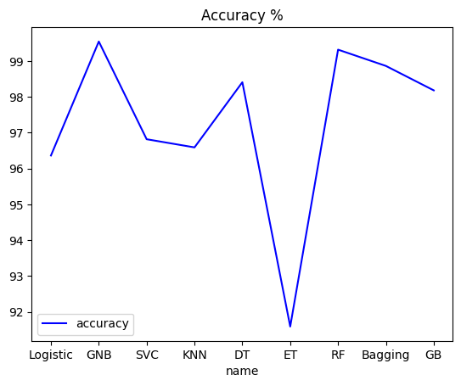
Accuracy of Models
Different types of Machine Learning Models were used to Predict the crop based on the soil composition. We used Logistic Regression, Gaussian Naïve Bayes, SVM, KNN, Decision Tree, Random Forest Classifier etc.
Based on the Graph Plotting we can see that Gaussian Naïve Bayes and Random Forest Classifier have the highest peak in the graph. We used Random Forest Classifier in predicting the crop as it is very simple to understand and use.

Slide 8
Process Workflow
Obtaining the data from the database and performing all the pre-processing steps like: a. Importing essential libraries b. Checking for missing value and outliers c. Splitting dataset into training and test sets
Normalizing the data, using MinMaxScaler to Normalize the data between [0,1]
Standardization: converting the mean value of data to 0 and standard deviation to 1.
Training the Random Forest Classifier Machine Learning Model, to predict the Crop.
Connecting the website with the program using Flask web framework.

Slide 9
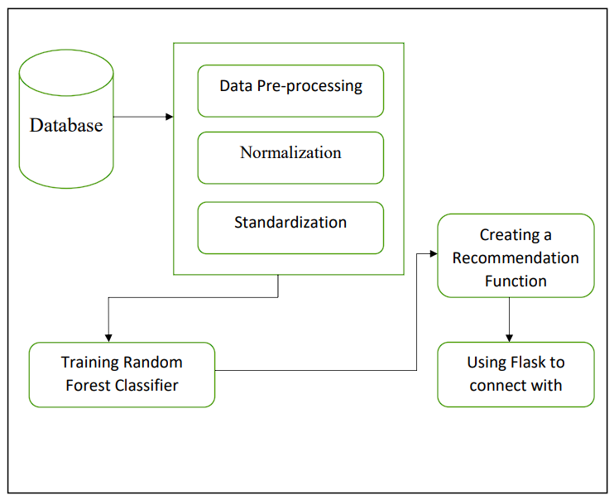
Process Workflow – flowchart
website

Slide 10
Conclusion
Machine learning technologies are frequently used for Crop Prediction. In this study, a variety of machine learning techniques are compared for the crop prediction based on soil composition, including Logistic Regression, Gaussian Naïve Bayes, SVM, KNN, Decision Tree, Random Forest, etc. on the soil - crop Dataset. The Random Forest Classifier, which obtained an accuracy of 99.31 percent, is the best method. This suggests that the Random Forest Classifier is the best method for detecting Crop Prediction using Soil Composition.

Slide 11
Thank You

